Slide 1
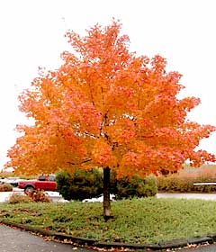
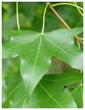
OPPD Forestry
Shantung Maple
Ht: 25’
Spread: 20’

Slide 2
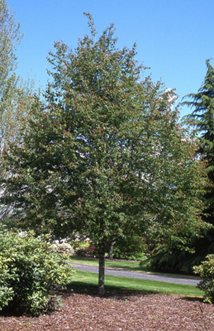
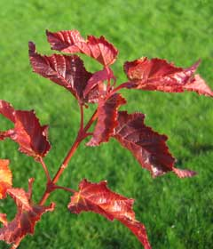

OPPD Forestry
Rugged Charm Tartarian Maple
Ht: 20’
Spread: 15’

Slide 3
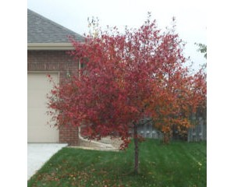
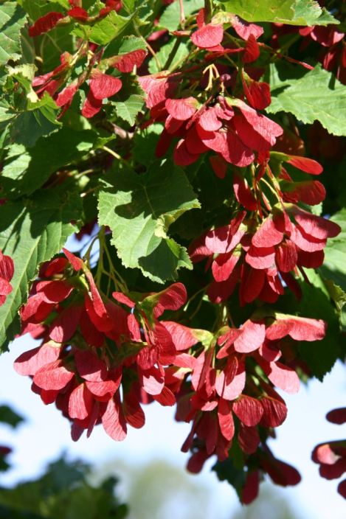
OPPD Forestry
Hot Wings Tatarian Maple
Ht: 20’-25’
Spread: 15’-20’

Slide 4
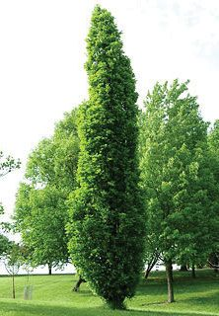
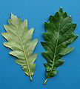
OPPD Forestry
Kindred Spirit Oak
Ht: 20’-30’
Spread: 4’-6’

Slide 5
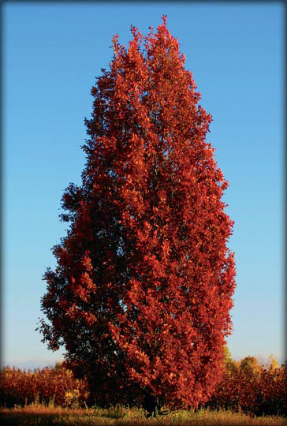
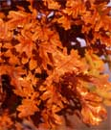
OPPD Forestry
Crimson Spire Oak
Ht: 45’
Spread: 15’

Slide 6
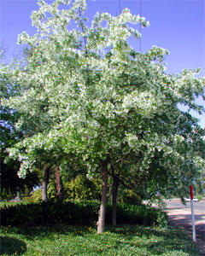
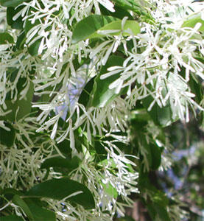
OPPD Forestry
Chinese Fringe Tree
Ht: 15’-20’
Spread: 15’-20’

Slide 7
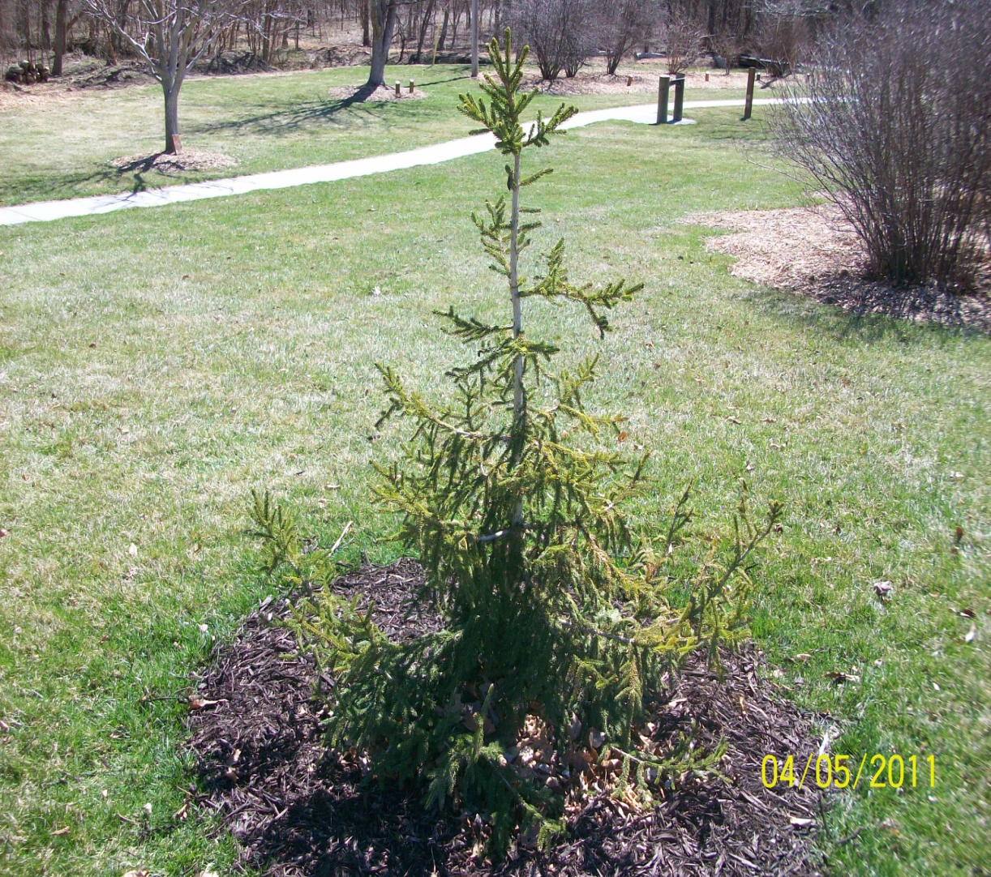
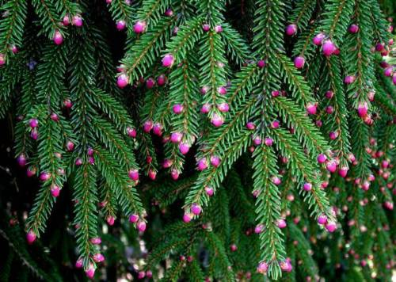
OPPD Forestry
Spruce Oriental ‘Gowdy’
Ht: 4’-6’
Spread: 3’-4’

Slide 8
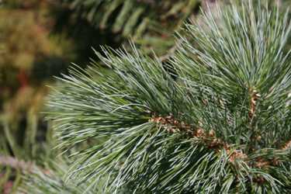
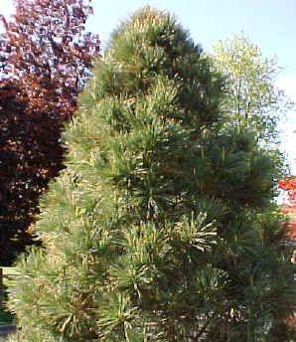
OPPD Forestry
Vanderwolf Pine
Ht: 20’-30’
Spread: 15’-20’

Slide 9
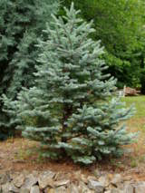
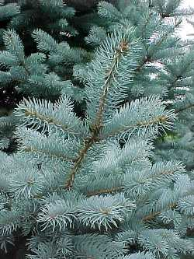
OPPD Forestry
Fat Albert Spruce
Ht: 10’-15’
Spread: 7’-10’

Slide 10
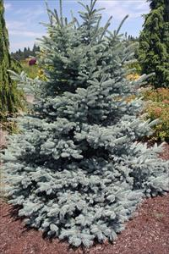
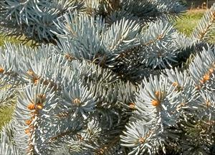
OPPD Forestry
Baby Blue Eyes Spruce
Ht: 12’-15’
Spread: 8’-10’

Slide 11
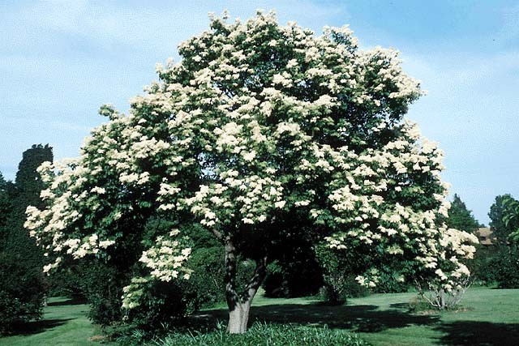
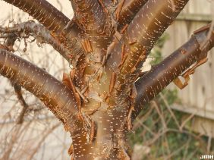
OPPD Forestry
China Snow Peking Lilac
Ht: 25’-30’
Spread: 20’-25’

Slide 12
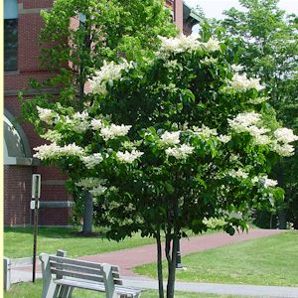
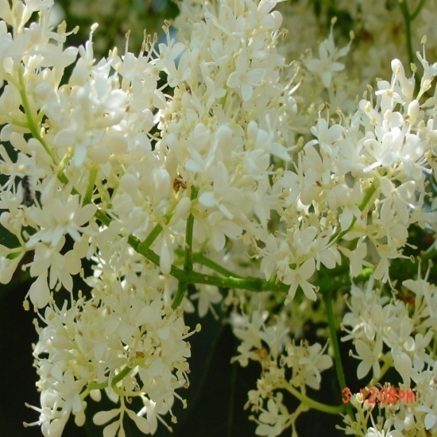
OPPD Forestry
Japanese Tree Lilac
Ht: 15’-25’
Spread: 15’-20’

Slide 13
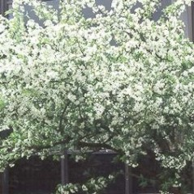
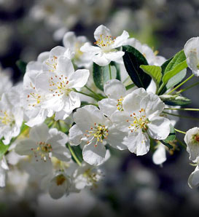
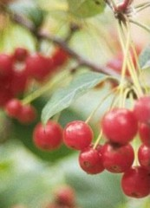
OPPD Forestry
Sergent Crabapple
Ht: 6’-8’
Spread: 9’-15’

Slide 14
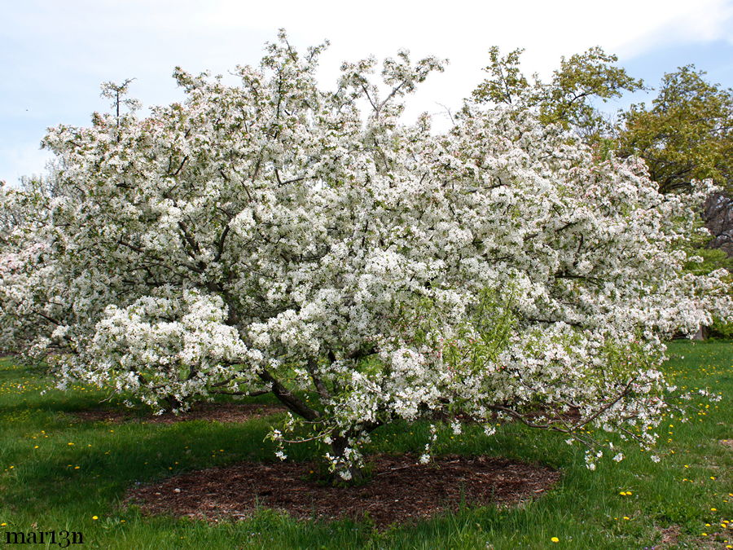
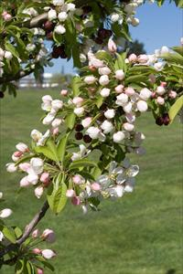
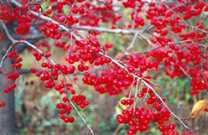
OPPD Forestry
Sugar Tyme Crabapple
Ht: 20 ft.
Spread: 15 ft.

Slide 15
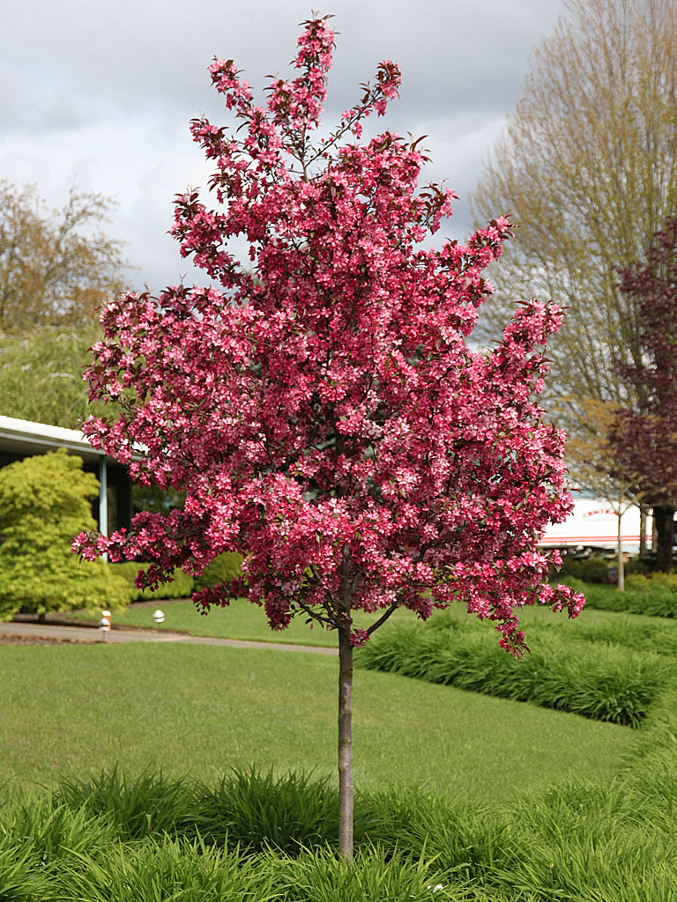
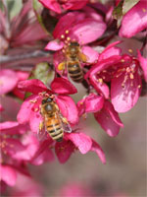
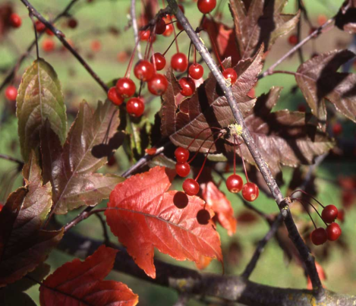
OPPD Forestry
Royal Raindrops Crabapple
Ht: 20’
Spread: 15’

Slide 16
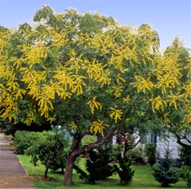
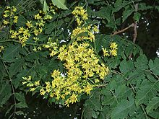
OPPD Forestry
Golden Rain Tree
Ht: 25’-30’
Spread: 25’-30’

Slide 17
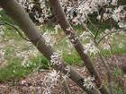
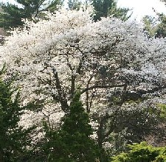
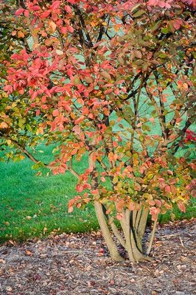
OPPD Forestry
Serviceberry
Ht: 15’-25’
Spread: 15’-20’

Slide 18
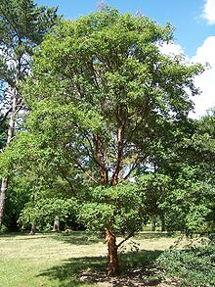
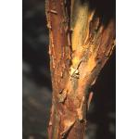
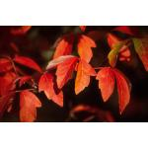
OPPD Forestry
Paperbark Maple
Ht: 20’-30’
Spread: 15’-20’

Slide 19
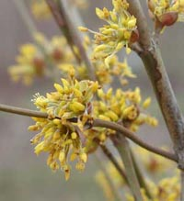
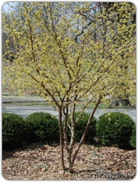
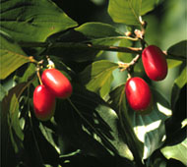
OPPD Forestry
Cornelian Cherry
Ht: 20’
Spread: 20’

Slide 20
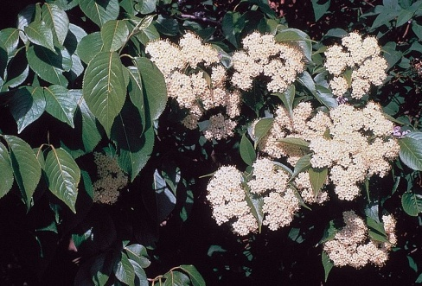
OPPD Forestry
Nannyberry Viburnum
Ht: 15’-18’
Spread: 8’-12’

Slide 21
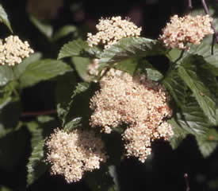
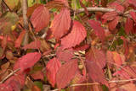
OPPD Forestry
Arrowwood Viburnum
Ht: 6’-8’
Spread: 6’-15’

Slide 22
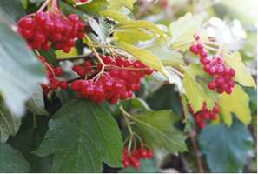
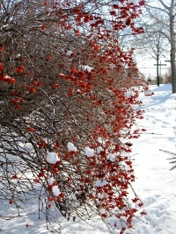
OPPD Forestry
American Highbush Cranberry Viburnum
Ht: 9’-12’ Spread: 9’-12’

Slide 23
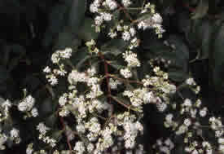


OPPD Forestry
Seven Sons Flower
Ht: 15’
Spread: 12’

Slide 24

OPPD Forestry
Common Lilac
Ht: 8’-15’
Spread: 6”-12”
Korean Lilac
Ht: 5’-7’
Spread: 5’-7’

Slide 25

OPPD Forestry
Burning Bush Euonymus
Ht: 9’-12’
Spread: 9’-12’

Slide 26



OPPD Forestry
Weigela
Ht: 3’-8’
Spread: 3’-8’

Slide 27



OPPD Forestry
Bottlebrush Buckeye
Ht: 6’-12’
Spread: 15’-20’

Slide 28



OPPD Forestry
Ht: 3’-5’
Spread: 3’-5’
Endless Summer Hydrangea

